Slide 1
K-12 School Shootings
Anagha, Sophia, and Kelly
Notes:
Hi My name Anagha, Sophia, Kelly
Anagha: Based on recent events, we were really motivated to studying school shootings and see if gun legislations has an affect on the amount of school shootings, and we wanted to see if we could predict the locations of school shootings.

Slide 2
Datasets- Collection and Cleanup
Data on K-12 School Shootings 1970-2020 from Center of Homeland Defense and Security (Biggest Data Set)
Dataset of Gun-Related Legislation Per Year Per State 1991-2017
Combined One Dataset with Data from US Census API to get a DataFrame of US Population by State 1990-2018
Notes:
Kelly
We got our data from 3 main data sets, k-12 school shootings (excel), gun-related legislation(csv), us population by state (by an api)

Slide 3
Data Exploration

Slide 4
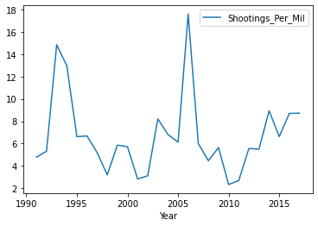
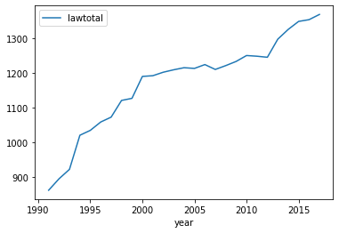
Rate of School Shootings and Gun Legislation Over Time
Notes:
Kelly
Left graph shows the total shootings per million people in the US from 1990-2017
We can see a peak between 1990-1995 and around 2006-2007
Right graph shows the total number of gun-related laws in the US from 1990-2017
We can see a steady increase, but doesn't seem to be directly affected by the number of school shootings

Slide 5
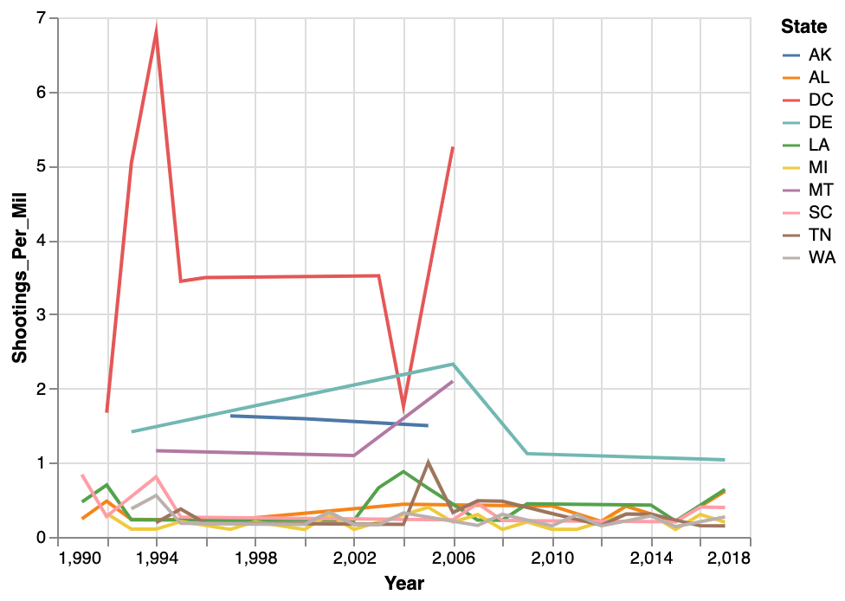
Rate of School Shootings Over Time from States with Most School Shootings
Notes:
Kelly:
The graph shows the number of shootings in the 10 states with most shootings from 1990-2017
Note that no data for that year means 0 school shootings recorded for the state and year
We can see that Washington DC, Delaware have an extremely high proportion of shootings to million people - probably because the population is so small.
Order: dc (31) , delaware (6.9), louisiana (6.6), alabama (5.5), southcarolina (5.3), tennessee(4.8), alaska (4.7), washington (4.3), montana (4.3), michigan (4.1)

Slide 6
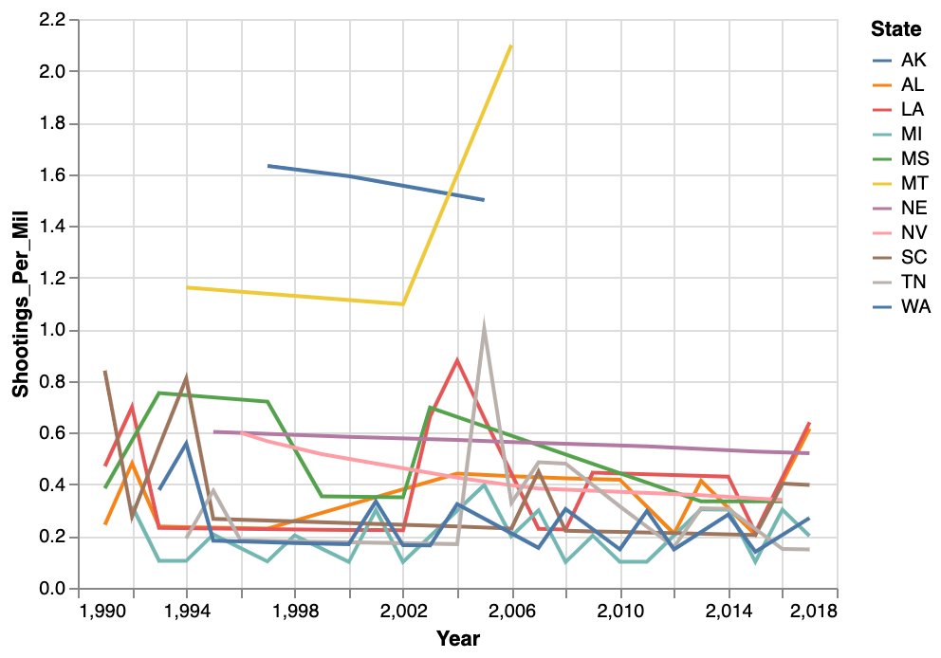
Adjusted Rate of School Shootings Over Time from States with Most School Shootings
Notes:
Kelly:
This graph just has the outliers with very small populations (DC and Delaware) removed so we can see the trend of the other states better
Louisiana (red) stands out and has a peak around 2004 and Tennessee (grey)

Slide 7
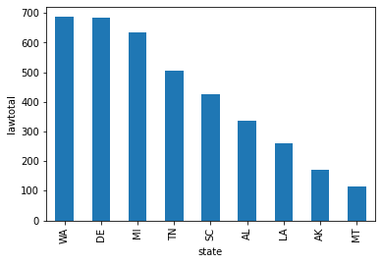
Number of Gun Laws from the States with the Most School Shootings
Notes:
Kelly:
This shows the total number of gun laws of the states with the most school shootings per capita (the top 9) (DC not counted)
(washington, delaware, michigan, tennessee, south carolina, alabama, louisiana, alaska, montana)

Slide 8
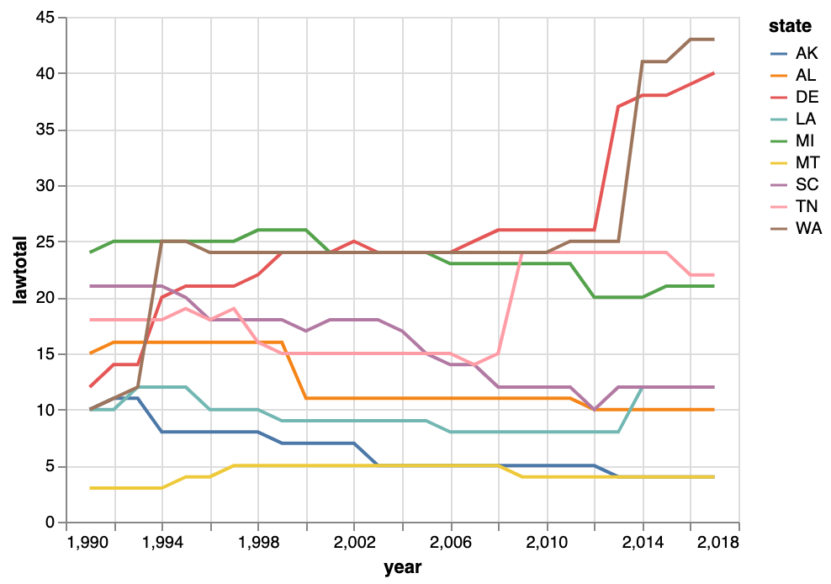
Gun Legislation Over Time from States with Most School Shootings
Notes:
Kelly
This graph shows the total number of laws as a function of time for the top 9 states with highest shootings per million
In delaware and washington state, the amount of legislation significantly increased since around 2012, possibly as a result of the Sandy Hook shooting at that time
Most states increased or kept the number of laws after Sandy Hook, except Alaska which shows a decrease
All states have less than 45.

Slide 9
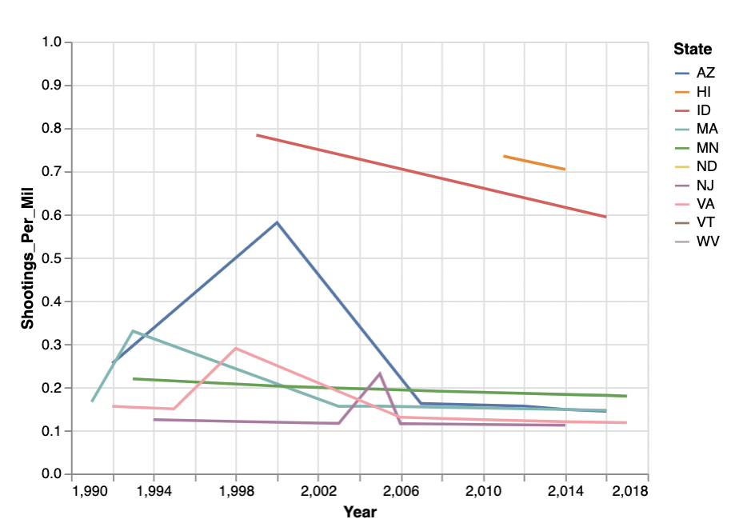
Rate of School Shootings Over Time from States with Least School Shootings
Notes:
The states with the least school shootings were west virginia, new jersey, massachusetts, virginia, idaho, hawaii, north dakota, minnesota, arizona, and vermont
The shootings per capita for most of the states stayed between 0.1 to 0.4 with 3 states (arizona, idaho, hawaii) having higher rates but nothing above 1
As we can see there is only school shootings in hawaii from 2011 to 2014. This can be attributed to the Highlands intermediate school shooting in 2011 and the President Theodore Rossebel HS shooting in 2014
As we can see there was a peak around the 1998-2000 for virginia, arizona, idaho and then the shootings per capita declines or stayed constant for the all the states.

Slide 10
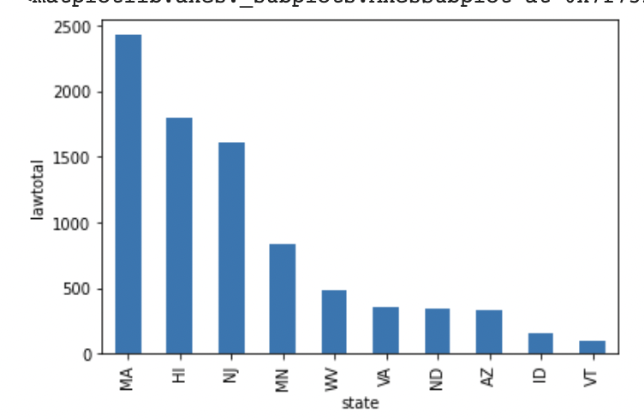
Number of Gun Laws from the States with the Least School Shootings
Notes:
We can see the total number of gun laws of the states with the least school shootings per capita. There is variety of the number of laws ranging from states having less than 500 laws to states having over 2000 laws from the years 1991-2017

Slide 11
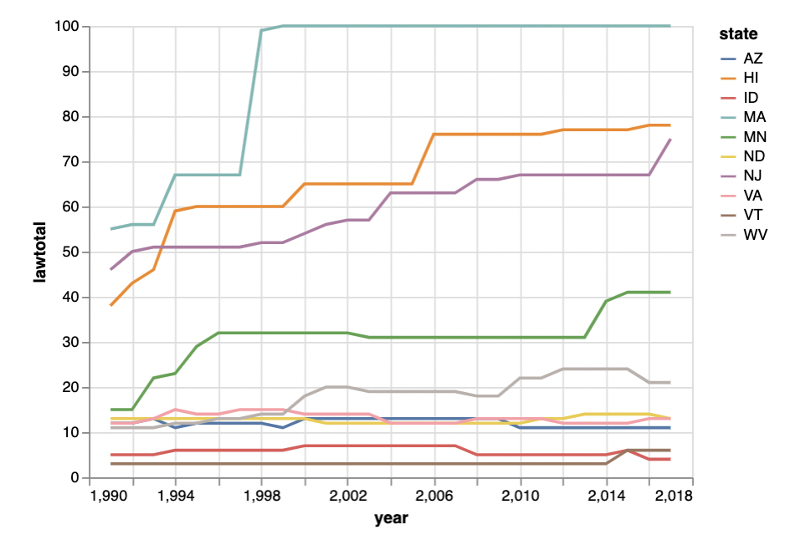
Gun Legislation Over Time from States with Least School Shootings
Notes:
Here we can see the total number of gun laws as a function of time for the top 10 states with least shootings per capita
Most states increased the number of laws around 1992/3 a few years after the Stockton schoolyard shooting in 1989
There is a split of around 5 states (massachusets, hawaii, new jersey, minnesota, west virginia) increasing the number of laws and then another 5 states (vermont, north dakota, virginia, arizona, idaho) staying constant for the number of gun laws

Slide 12
School Shootings Compared to the Gun Legislation Over Time

Slide 13
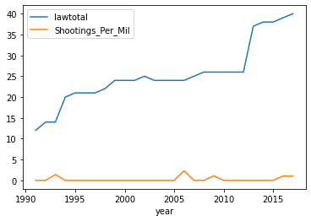
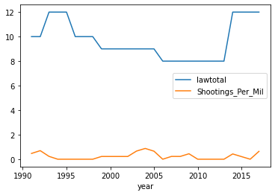
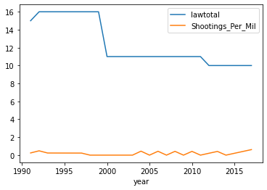
States with the Most School Shootings
Louisiana #2
Delaware #1
Alabama #3
Notes:
Kelly: For the top 3 states with the most shootings per million people, we graphed the shootings per million and the total number of laws are functions of time on the same graph to check whether there was a correlation between the variables.
Notice that there isn’t a noticeable correlation

Slide 14
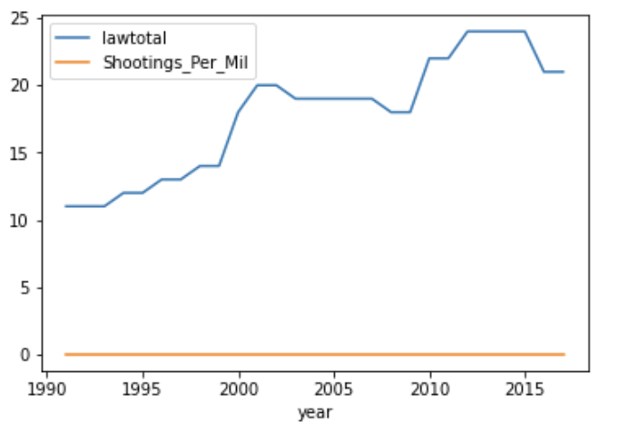
State with the Least School Shootings
West Virginia #1
Notes:
we graphed the shootings per capita and the total number of laws are functions of time on the same graph to check whether there was a correlation between the variables.
Here we se that there is barely any school shootings over the decades but the numbr of gunlaws increase around the times of deadly school shootings columbine in 1999 and sandy hook shooting in 2012
Notice that there isn’t a noticeable correlation. The rate of school shootings over the years is very minimal but there is an increase in gun legislation

Slide 15
Number of Laws in Each Category
Notes:
What are these gun laws that states are passing. There was 133 different gun laws from the dataset we used and we grouped them into categories which were based on 'Age','background_checks','buyer_regulations','dealer_regulations',domestic violence ,'buyer_prohibition','possession_regulations','bans','child_safety' laws
The gun law category that has the most laws is dealer regulations (which include dealers having to report their sales or report stolen guns) and the category of buyer prohibitions (which prohibits people who have committed a violent misdeamoner, a feloney, alcohol related problems)
The gun category that has the least laws are bans (which consisted of bans on sales of certain assault weapons or magazines) and age restricitons ( such as buying a hand gun or long ugn at age 18 or age 21

Slide 16
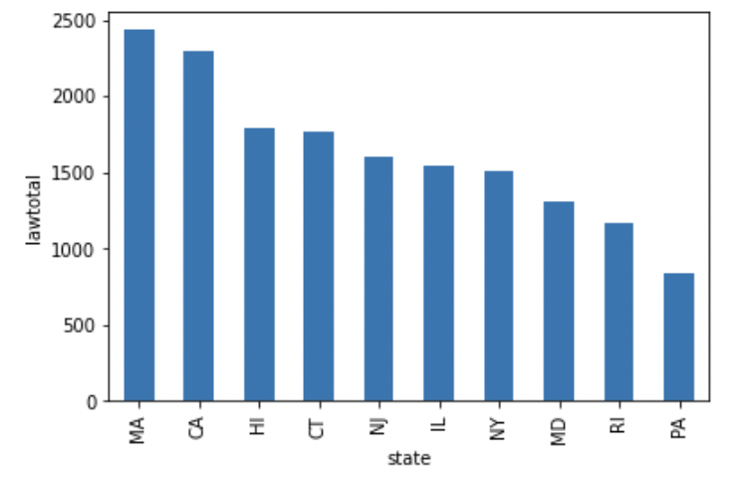
States with the Most Gun Laws
Notes:
We also found the states with the most gun laws over 1991-2017 (massachusetss, california, hawaii, connecticut, new jersey, illinois, new york, maryland, rhose island and pennsylvania) which ranged from around 1000 to 2500 gun laws
We mainly found this group to see if we could find states that had the least school shootings per captia also in this group
We found 2 states that overlapped between the most gun laws and the least school shootings per capita group, and these states were massachusetts and hawaii, but the other states in this category also had lowe school shootings per capita

Slide 17
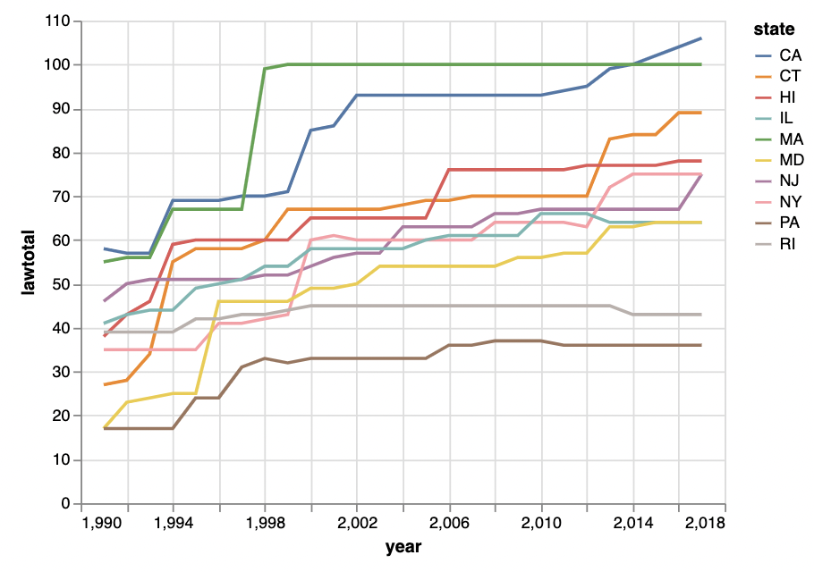
Gun Legislation Over Time for the States with the Most Gun Laws
Notes:
We graphed the gun legislation over time for states with the most gun laws
As we saw earlier the states with the most school shootings had around 30 gun laws which contrasts these states
The states in this graph contrats this, as they start off with higher than 30 gun laws for most of the states and continue to increase as the years pass.
Overall we see that states with least school shootings had an increase in gun laws or stayed constant

Slide 18
Machine Learning

Slide 19
Dataset - Variables
9 Variables: State, School Level, Time Period, During School, Targets, Situation, Bullied, Preplanned, Weapon Type
Variable to Predict: Location
Parking Lot, Classroom, Beside Building

Slide 20
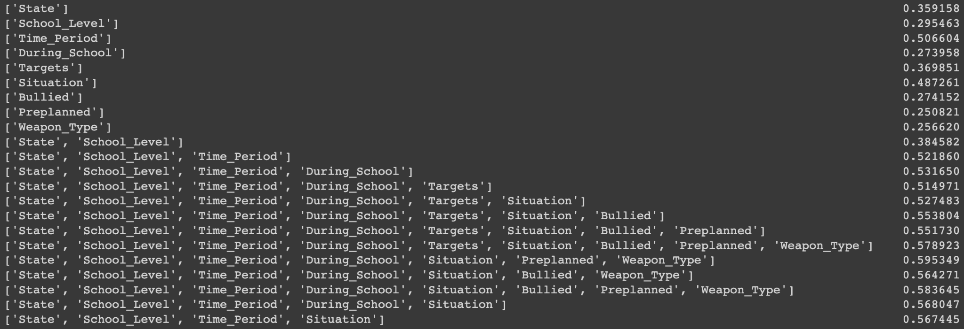
Best Model

Slide 21
Test Metrics
Accuracy of Model: 71.5%
Parking Lot: Precision: 79% Recall: 69.5%
Classroom: Precision: 74% Recall: 81%
Beside Building: Precision: 58.5% Recall: 65.5%

